Slide 1

DATABASE SYSTEMS (EIE36E): Data Protection in Database Systems
Doc. Ing. Václav Vostrovský Ph.D.
Ing. Petr Hanzlík

Slide 2

Outline
Why DB Security
Threats to Databases
Database security concept
C.I.A triangle
Database Security practices
Database Security levels
DB environment components
Security Methods
Protecting data within database
Conclusions

Slide 3
Why DB Security
Unauthorized or unintended activity or misuse by authorized DB users
Malware infections causing incidents
Overloads, performance constraints and capacity issues
Physical damage to database servers
Design flaws and programming bugs in databases and the associated programs and systems,
Data corruption and/or loss

Slide 4
Database security concept
Information security controls to protect DB
Data
DB applications or stored functions
DB systems
DB servers
Associated network links

Slide 5
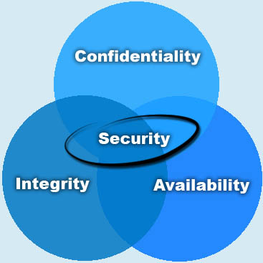
C.I.A triangle
Who should have the right to access data?
What portion of all the data should a particular user be able to access?
What operations should an authorized user be able to perform on the data?
Can authorized users access
valid data when necessary?

Slide 6
Database security levels
Relational database: collection of related data files
Data file: Collection of related tables
Table :Collection of related rows (records)
Row:Collection of related columns

Slide 7
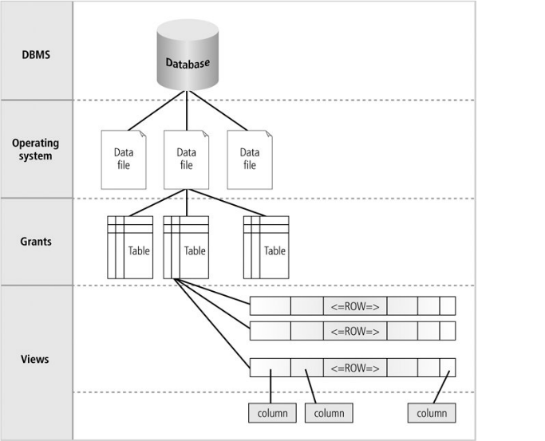
Database security levels

Slide 8
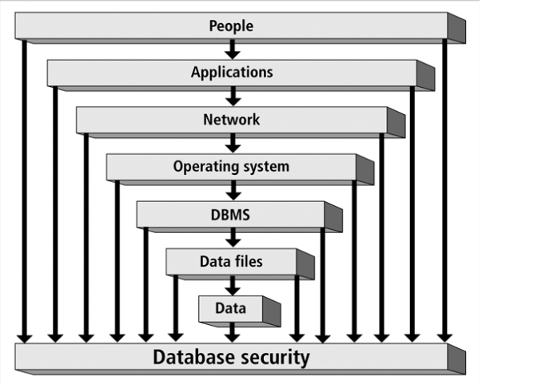
DB environment components

Slide 9
People
Physical limits on access to hardware and documents
Identification and Authentication
Trainings on security importance and how to guard assets
Establishment of security policies and procedures

Slide 10
Application
Authentication of users who access applications
Business rules( Implementation of a bussiness procedure)
Single sign-on(signing on once for different application and websites)

Slide 11
Network
Firewalls to block network intruders:
block the well-known database ports in firewalls. Microsoft SQL use UDP port number 1434 and oracle’s listening port is 1521 to 1530.
Virtual private network (a remote computer securely connected to a corporate network
Authentication

Slide 12
Operating system
Authentication
Intrusion detection
Password policy
User accounts

Slide 13
DBMS
Authentication
Audit Mechanism
Database resource limits
Password policy

Slide 14
Data
Data validation
Data constraints
Data encryption
Data access

Slide 15
Protecting data within database
System and Object Privileges
Managing System and Object Privileges
Encrypting Data on the Server
Database Integrity Mechanisms
System Availability Factors

Slide 16
System and Object Privileges
Privilege: permission to access a named object in a prescribed manner (query a table).
Privileges are granted to users from DBA.
Privileges can be granted to:
enable a particular user to connect to the database
create a table in his own schema;
select rows from someone else's table
execute someone else's stored procedure.

Slide 17
System Privileges
Allow users to perform a particular systemwide action or a particular action on a particular type of schema object.
E.g, the privileges to create a tablespace
delete the rows of any table in the database
Many system privileges are available only to administrators and application developers

Slide 18
Schema Object Privileges
Allow users to perform a particular action on a specific schema object. (e.g delete rows of a specific table is an object privilege.)
Privileges can be specified:
at the column level.
at the row level.
Object privileges can only be granted by the object owner.
An owner can also specify that a particular user has the right to grant a privilege to others.

Slide 19
Managing System and Object Privileges
Using Roles to Manage Privileges
Using Stored Procedures to Manage Privileges
Using Network Facilities to Manage Privileges
Using Views to Manage Privileges

Slide 20
Using Roles to Manage Privileges
A role mechanism can be used to provide authorization.
A single person or a group of people can be granted a role or a group of roles.
One role can be granted in turn to other roles.
By defining different types of roles, administrators can manage access privileges much more easily.

Slide 21
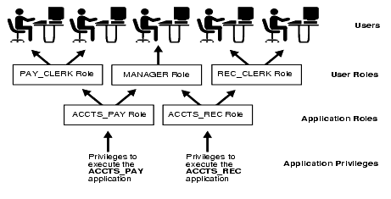
Using Roles to Manage Privileges

Slide 22
Stored Procedures to Manage Privileges
Restrict the database operations that users can perform.
Access of data only through procedures and functions that execute with the definer's privileges.
Users with the privilege to execute the procedure (but not the privileges to query, update, or delete from the underlying tables) can invoke the procedure, but they cannot manipulate table data in any other way.

Slide 23
Stored Procedures to Manage Privileges
Restrict the database operations that users can perform.
Access of data only through procedures and functions that execute with the definer's privileges.
E.g. you can grant users access to a procedure that updates a table, but not grant them access to the table itself. When a user invokes the procedure, the procedure executes with the privileges of the procedure's owner.
Users with the privilege to execute the procedure (but not the privileges to query, update, or delete from the underlying tables) can invoke the procedure, but they cannot manipulate table data in any other way.

Slide 24
Why use Views ?
Security (when users should only see certain rows or columns of a table.)
Simplifying user SQL
Making data comprehensible. Table and column names are often long and pretty meaningless.The view and its columns can be much more obvious
Performance

Slide 25
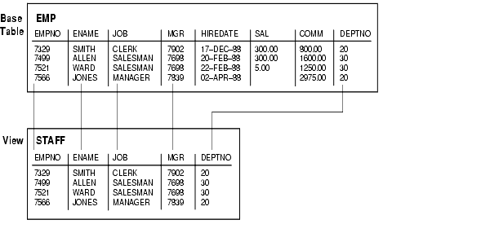
Using Views to enforce Security
Notes:
Do not forget to turn autocommit off!

Slide 26
Encrypting Data on the Server
Encryption - technique of encoding data
Only authorized users can understand it.
Encryption alone, however, is not sufficient to secure your data.
Protecting data in the database includes access control, data integrity, encryption, and auditing.

Slide 27
Database Integrity Mechanisms
Ensures that data in the database is correct and consistent:
System integrity mechanisms
ensuring that the data inserted into the system is the same as the contents of that data when it is subsequently retrieved
data must not be altered or deleted by a user who is not authorized to do so.
Mechanisms that enforce relational database integrity properties (like entity integrity, referential integrity, transaction integrity, and business rules).

Slide 28
System Availability Factors
Data security also involves the accessibility of the data to authorized users, as needed.
Availability - continuity of service, 24/7
Security aspects to availability:
if a user is able to manipulate system resources in order to deny their availability to other users, he is breaching security ( denial of service)

Slide 29
System Availability Factors
Storage quotas
Resource limits
Hot backups
Resistance to attack - secure coding standards.
Secure configuration
Parallel systems - Clusters

Slide 30
Conclusions
Revoke privileges from public accounts
Lock unused accounts
Change any default passwords after installation
Set the proper permissions. (You may implement roles to manage privileges, but if permissions are incorrectly set in the operating system, there may be a security loophole. )
Physical protection

Slide 31
Conclusions
Apply security patches
Block firewall ports used by database
Validate input to the database
Remove unwanted stored procedures
Use stored procedures for repetitive work
Backup your data
Private network/wiring
Encryption
Training

